Slide 1
BASKETBALL LESSON INFOGRAPHICS
Here is where this template begins

Slide 2
ABOUT BASKETBALL LESSON INFOGRAPHICS
This template contains an assortment of complementary infographic resources for the Basketball Lesson presentation.
These infographics are adapted to the style of the aforementioned presentation, so you can insert them easily and have them completely integrated at once. You just need to do the following:
Select the element that you want to copy
Right-click and choose “Copy”
Go to the slide where you want the element to appear
Right-click and choose “Paste”

Slide 3
BASKETBALL LESSON
02
LAYUP
Venus has a very beautiful name
01
03
DUNK
HOOK
Mercury is the smallest planet of them all
Jupiter is named after a Roman god

Slide 4
BASKETBALL LESSON
01 | FOUL | Mercury is a very small planet
02 | STEPS | Jupiter is the biggest planet
03 | DOUBLE DRIBBLE | Despite being red, it is cold
04 | TURNOVER | Earth is the planet that harbors life

Slide 5
BASKETBALL LESSON
ACTIONS
REBOUND
FAKE
DRIBBLE
Jupiter is a gas giant and the biggest planet
Mercury is the closest planet to the Sun
Neptune is the farthest planet from the Sun
Despite being red, Mars is a cold place
Pluto is considered a dwarf planet
Earth is the third planet from the Sun

Slide 6
BASKETBALL LESSON
TEAM 1
Fred A. Bell
Kathy M. Brown
Lisa C. Brewer
Rob Pierre
Jason D. Clark
TEAM 2
Charles E. Schmidt
Jeffrey B. Wiggins
Joanne Lindman
Wendy J. Chang
Lisa D. Lopez

Slide 7
BASKETBALL LESSON
GAME BASICS
01
45%
55%
02
ATTACK
DEFENSE
Mercury is the smallest planet of them all
Venus has a very beautiful name

Slide 8
BASKETBALL LESSON
TRAINING
 | ACTIVITY | EXERCISE
8:00 | Pass | Venus has a nice name
8:30 | Assist | Despite being red, Mars is cold
9:00 | Layup | Jupiter is the biggest planet
10:00 | Reverse layup | Saturn is a gas giant with rings
11:00 | Rebound | Neptune is far away from us

Slide 9
BASKETBALL LESSON
01
JUPITER
Jupiter is the biggest planet
02
MARS
Despite being red, it is cold
03
VENUS
Venus has a beautiful name
04
EARTH
We all live on planet Earth

Slide 10
BASKETBALL LESSON
TRAINING | 1ST SESSION | 2ND SESSION | 3RD SESSION
DRIBBLING | Mercury is the smallest planet | Mars is actually a very cold place | Saturn is a gas giant with several rings
PASSING | Venus has a beautiful name but is hot | Jupiter is the biggest planet of them all | Earth is the planet where we live on
SHOOTING | Neptune is very far from the Sun | Ceres is located in the main asteroid belt | Pluto is considered a dwarf planet

Slide 11
BASKETBALL LESSON
STEP
03
STEP
02
JUPITER
STEP
Jupiter was named after a Roman god
01
VENUS
Venus has a very beautiful name
MERCURY
Mercury is the smallest planet of them all

Slide 12
BASKETBALL LESSON
01 | BOUNCE | Mercury is a very small planet
02 | BEND KNEES | Jupiter is the biggest planet of them all
03 | HEAD UP | Despite being red, Mars is cold
04 | SHIELD THE BALL | Earth is the planet that harbors life
BASKETBALL SKILLS

Slide 13
BASKETBALL LESSON
PASS
LAYUP
Jupiter is the biggest planet
We all live on planet Earth
DRIBBLE
CROSS-OVER
SHOOT
Mercury is a very small planet
Despite being red, Mars is cold
Venus has a beautiful name

Slide 14
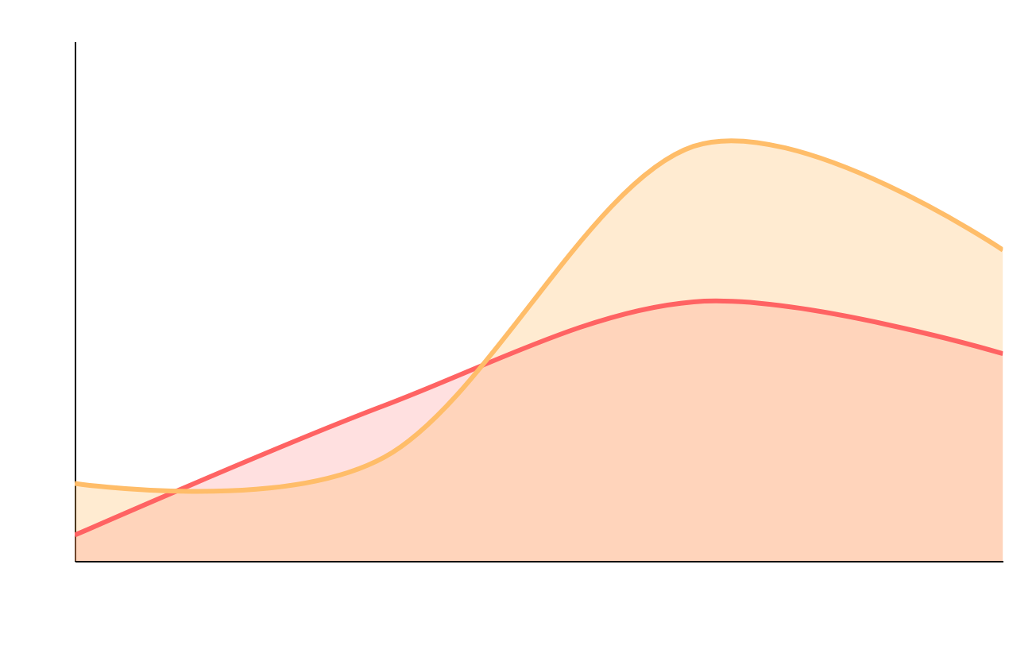
BASKETBALL LESSON
POSSESSION TIME
TEAM 1
50%
TEAM 2
25%
Mercury is the closest planet to the Sun and the smallest one
Follow the link in the graph to modify its data and then paste the new one here. For more info, click here

Slide 15
BASKETBALL LESSON
SHOTS |  | THROWS | POINTS
THREE POINT | 7.24 m | 1 | 3
TWO-POINT | -7.24 m | 1 | 2
FREE THROW 03 | 5.8 m | Depends | 1

Slide 16
BASKETBALL LESSON
Jupiter is gas giant and the biggest planet
Mercury is the closest planet to the Sun
Venus has a beautiful name but is very hot
Earth is the third planet from the Sun
DO’S
Neptune is the farthest planet from the Sun
Despite being red, Mars is a cold place
Saturn is a gas giant and has several rings
Ceres is located in the main asteroid belt
DON’TS

Slide 17
BASKETBALL LESSON
SHOT
Earth is the planet that harbors life
25%
45%
30%
PASS
REBOUND
Jupiter is the biggest planet
Despite being red, Mars is cold

Slide 18
BASKETBALL LESSON
Jupiter is a gas giant
Mercury is the smallest planet
Venus has a beautiful name
Earth is where we all live on
Mars is actually a cold place
Pluto is a dwarf planet
Ceres is in an asteroid belt
Neptune is far away from us
The Moon is our satellite
The Sun is a huge and hot star
ZONE DEFENSE
MAN TO MAN
VS

Slide 19
BASKETBALL LESSON
02
ASSIST
Venus has a very beautiful name
01
03
PASS
RECEPTION
Mercury is the smallest planet of them all
Jupiter was named after a Roman god

Slide 20
BASKETBALL LESSON
01
BOUNCE
Mercury is the smallest planet of them all
03
02
DUNK
Jupiter was named after a Roman god
LAYUP
Venus has a very beautiful name

Slide 21
BASKETBALL LESSON
TEAM A
INSTRUCTORS
TEAM B
Irma R. Kennedy
Mercury is the closest planet to the Sun and the smallest one in the entire Solar System
Judy M. Graff
Charles J. Johnson
Benjamin S. Romero
Crystal J. Alvarez
Rose Christine
Virginia J. Miles
Corey Love

Slide 22
BASKETBALL LESSON
01
ATTACK
Mercury is the closest planet to the Sun and the smallest one in the Solar System
02
BASKETBALL TACTICS
DEFENSE
Venus has a beautiful name and is the second planet from the Sun

Slide 23
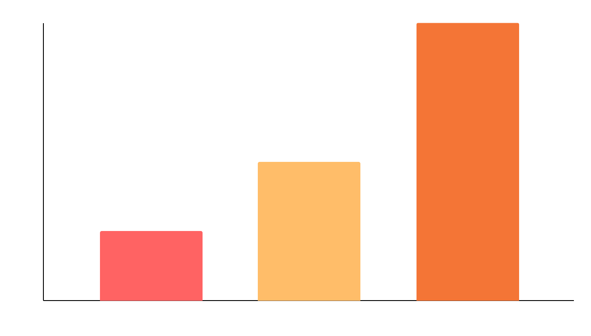
BASKETBALL LESSON
SHOOTING EFFECTIVITY
COMPETITOR 1
25%
Neptune is the farthest planet from the Sun
COMPETITOR 2
50%
Despite being red, Mars is a cold place
OUR TEAM
100%
Pluto is considered a dwarf planet
Follow the link in the graph to modify its data and then paste the new one here. For more info, click here

Slide 24
BASKETBALL LESSON
75%
25%
VENUS
EARTH
Venus has a very beautiful name but is actually terribly hot, even hotter than Mercury
Earth is the third planet from the Sun and the only one that harbors life in the Solar System

Slide 25
BASKETBALL LESSON
MERCURY
VENUS
Mercury is the smallest planet
Venus has a beautiful name
STEP 1
STEP 2
STEP 3
STEP 4
MARS
JUPITER
Mars is actually a very cold place
Jupiter is the biggest planet

Slide 26
BASKETBALL LESSON
BASKETBALL LESSON
1ST PHASE
2ND PHASE
MARS
MERCURY
JUPITER
VENUS
Mars is actually a very cold place
Mercury is the smallest planet
Jupiter is the biggest planet
Venus has a beautiful name

Slide 27
BASKETBALL LESSON
75%
65%
55%
REBOUND
BOUNCE
ASSIST
Mercury is the closest planet to the Sun
Venus has a
beautiful name
Neptune is the farthest planet from the Sun

Slide 28
BASKETBALL LESSON
3/5
5/5
MERCURY
MARS
Mercury is the closest planet to the Sun
Despite being red, Mars is actually a really cold place

Slide 29
BASKETBALL LESSON
 | MON | TUE | WED | THU | FRI
WEEK 1 | Bouncing | Passing | Dribble | Rebound | Shoot
WEEK 2 | Faults 1 | Three-point | Two-point | Layup | Defense
WEEK 3 | Zone | Man to man | Counter | Faults 2 | Dunk
WEEK 4 | Assist | Passing | Rebound | Free throw | Control

Slide 30
BASKETBALL LESSON
Neptune is the farthest planet from the Sun
NEPTUNE
COMPETITION
OUR GOALS
Jupiter is a gas giant and the biggest planet
JUPITER
Mercury is the closest planet to the Sun
MERCURY
FAIR PLAY
Earth is the third planet from the Sun
EARTH

Slide 31
BASKETBALL LESSON
ZONE DEFENSE
POSSESSION
COUNTER ATTACK
Mercury is the closest planet to the Sun
Pluto is considered a dwarf planet
Neptune is the farthest planet from the Sun
JAN | FEB | MAR | APR | MAY | JUN | JUL | AUG | SEP | OCT | NOV | DEC

Slide 32
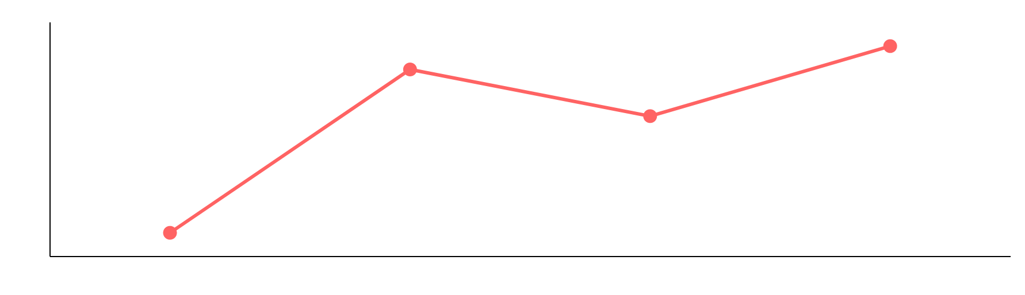
BASKETBALL LESSON
SEASON 1
COMMITTED FAULTS
Mercury is the closest planet to the Sun and the smallest one of all the planets in the Solar System
TOTAL FAULTS
+25%
Follow the link in the graph to modify its data and then paste the new one here. For more info, click here

Slide 33
Instructions for use
If you have a free account, in order to use this template, you must credit Slidesgo in your final presentation. Please refer to the next slide to read the instructions for premium users.
As a Free user, you are allowed to:
- Modify this template.
- Use it for both personal and commercial projects.
You are not allowed to:
- Sublicense, sell or rent any of Slidesgo Content (or a modified version of Slidesgo Content).
- Distribute Slidesgo Content unless it has been expressly authorized by Slidesgo.
- Include Slidesgo Content in an online or offline database or file.
- Offer Slidesgo templates (or modified versions of Slidesgo templates) for download.
- Acquire the copyright of Slidesgo Content.
For more information about editing slides, please read our FAQs or visit our blog:
https://slidesgo.com/faqs and https://slidesgo.com/slidesgo-school

Slide 34
Instructions for use (premium users)
As a Premium user, you can use this template without attributing Slidesgo.
You are allowed to:
Modify this template.
Use it for both personal and commercial purposes.
Share this template in an editable format with people who are not part of your team.
You are not allowed to:
Sublicense, sell or rent this Slidesgo Template (or a modified version of this Slidesgo Template).
Distribute this Slidesgo Template (or a modified version of this Slidesgo Template) or include it in a database or in any other product or service that offers downloadable images, icons or presentations that may be subject to distribution or resale.
Use any of the elements that are part of this Slidesgo Template in an isolated and separated way from this Template.
Register any of the elements that are part of this template as a trademark or logo, or register it as a work in an intellectual property registry or similar.
For more information about editing slides, please read our FAQs or visit our blog:
https://slidesgo.com/faqs and https://slidesgo.com/slidesgo-school

Slide 35
Infographics
You can add and edit some infographics to your presentation to present your data in a visual way.
Choose your favourite infographic and insert it in your presentation using Ctrl C + Ctrl V or Cmd C + Cmd V in Mac.
Select one of the parts and ungroup it by right-clicking and choosing “Ungroup”.
Change the color by clicking on the paint bucket.
Then resize the element by clicking and dragging one of the square-shaped points of its bounding box (the cursor should look like a double-headed arrow). Remember to hold Shift while dragging to keep the proportions.
Group the elements again by selecting them, right-clicking and choosing “Group”.
Repeat the steps above with the other parts and when you’re done editing, copy the end result and paste it into your presentation.
Remember to choose the “Keep source formatting” option so that it keeps the design. For more info, please visit our blog.

